Slide 1

Armed Forces College of Medicine
AFCM

Slide 2
GIT Symptoms (1)
Written by
Ass. Prof. Ahmed Elshafie

Slide 3
Intended Learning Outcomes (ILOs)
By the end of this lecture the student will be able to:
Define different gastrointestinal symptoms.
List the differential diagnosis of different gastrointestinal symptoms.
Identify alarm features of gastrointestinal symptoms.
Apply scientific approach based on patient clinical data & investigations that help reach specific diagnosis of different gastrointestinal symptoms.

Slide 4
Approach to Dysphagia

Slide 5
Definitions
Dysphagia:
- Difficulty starting a swallow or the sensation of food being stuck in the neck or chest.
- There is abnormal delay in bolus transit.
Dysphagia needs to be distinguished from odynophagia and from globus sensation.

Slide 6
Definitions
Odynophagia:
Painful swallowing (infection or inflammation).
Globus sensation:
A constant sensation of a lump or tightness sensation in the throat unrelated to swallowing.

Slide 7
Etiology of Dysphagia
[A] Oropharyngeal causes
[B] Esophageal causes
(1) Neuromuscular causes
(2)
Structural causes
(1) Neuromuscular causes
(2)
Structural causes
Lumen
Lumen
Wall
Wall
Compression from outside
Compression from outside

Slide 8
[A] Oropharyngeal Dysphagia
Difficult initiation of swallowing process from mouth to esophagus
(1) Neuromuscular causes
(2) Structural causes
Lumen
Wall (Stricture)
Outside Compression
Stroke
Cerebral palsy
Multiple sclerosis
Amyotrophic lateral sclerosis
Parkinson’s disease
Myopathies
Polymyositis/dermatomyositis
Myasthenia gravis
Pharyngeal webs (Plummer-Vinson syndrome)
Oro-pharyngeal neoplasms (rare)
Zenker diverticulum
Iatrogenic
Radiation therapy
Corrosive pill injury
- Anticholinergic medications (dries mucous membranes)
Thyromegaly
LN
Head and neck tumors or surgery
Retro-pharyngeal abscesses
Cervical spondylosis
Vertebral osteophytes

Slide 9
[B] Esophageal Dysphagia
Sensation of food being stuck in the neck or chest
(1) Neuromuscular causes
(2) Structural causes
Lumen
Wall (Stricture)
Outside Compression
Achalasia
Diffuse esophageal spasm
Nutcracker esophagus
Scleroderma
Sjögren syndrome
Chagas disease
Foreign bodies
Food impaction
Rings - webs
Tumor
Peptic stricture (2ry to GERD)
Esophageal carcinoma
Infectious esophagitis (HSV-Candida-CMV)
Eosinophilic esophagitis
Iatrogenic
- Chemical injury (caustic ingestion, pill
esophagitis, variceal sclerotherapy )
- Radiation injury
Dysphagia lusoria
Left atrial enlargement
Mediastinal LN
Substernal thyroid
Postsurgical fundoplication, antireflux devices

Slide 10
Most Common Causes
Obstructive lesion in the oesophagus: (47%)
- Peptic stricture.
- Esophageal Carcinoma.
- Esophageal Rings & webs.
Esophageal Motility disorders: (32%)
- Primary: Diffuse esophageal spasm.
- Secondary: 2ry Achalasia, Scleroderma.
Others: (21%)
- Oropharyngeal: Stroke……….

Slide 11
Common drugs causing Pill esophagitis
Doxycycline
NSAIDs
Alendronate (a bisphosphonate medication - used to treat osteoporosis by inhibiting osteoclast-mediated bone-resorption).
Potassium chloride

Slide 12
Alarm symptoms
Older patients presenting with:
- progressive dysphagia.
- Anorexia.
- Significant unintentional weight loss.
- Particularly those with a past history of:
alcohol abuse, smoking, obesity, or GERD.
This should raise concern about an underlying oropharyngeal or esophageal malignancy.
Endoscopy

Slide 13
Investigations for Dysphagia
The medical history is the basis for initial testing.
Patients usually require early referral, since most will need an endoscopy.
[A] Imaging:
Barium Swallow (esophageal).
Video fluoroscopy “modified barium swallow” (Gold standard for oropharyngeal dysphagia).
CT/PET scan (Neck – Thoracoabdominal) for detection etiology of external compression or cancer staging (e.g. Thyroid – L.N.).

Slide 14
Investigations for Dysphagia
[B] Endoscopy: (Gold standard for structural causes of dysphagia):
- Nasoendoscopy.
- Esophagogastroduodenoscopy ± biopsy.
- EUS.
[C] Manometry:
- Achalasia - diffuse esophageal spasm - scleroderma.
[D] Water Swallow test (potentially useful basic screening test for oropharyngeal dysphagia).

Slide 15
Approach to Patient with Dysphagia
Difficulty in swallowing
Food stuck immediately after swallow associated with coughing, chocking &/or nasal regurgitation.
Food stop a few seconds after swallowed.
Oropharyngeal Dysphagia
Esophageal Dysphagia
Video fluoroscopy

Slide 16
Esophageal Dysphagia
Solid & liquid
Solid only
Motility problem
Structural Abnormality
Progressive
Intermittent
Intermittent
Progressive
& Regurgitation
& Acid
& Chest pain
Ring Eosinophilic esophagitis
& Acid
& > 50 year Weight loss
Achalasia
Scleroderma
Esophageal spasm
GERD
Cancer
Esophageal manometry
Barium Swallow
Upper GI endoscopy
CT - EUS

Slide 17
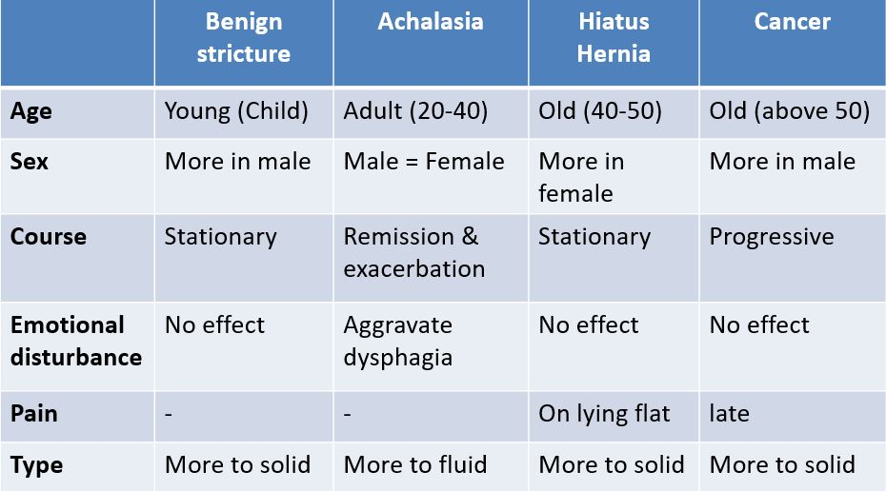
Differential diagnosis of common causes of dysphagia

Slide 18
Functional Dysphagia
structural or neuromuscular abnormalDysphagia in the absence of any ities of the esophagus (normal transit) (a diagnosis of exclusion).
Mechanism:
Unknown.
But potentially related to visceral hypersensitivity, inappropriate pain perception, or unidentified contraction abnormalities.

Slide 19
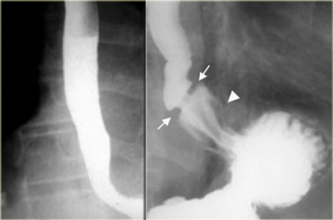

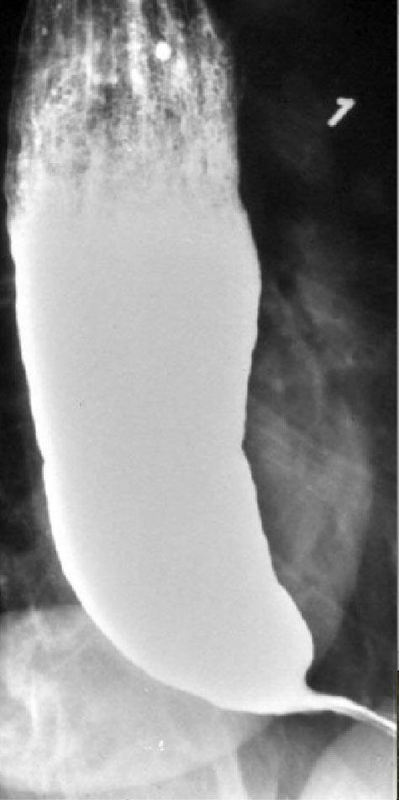

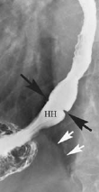
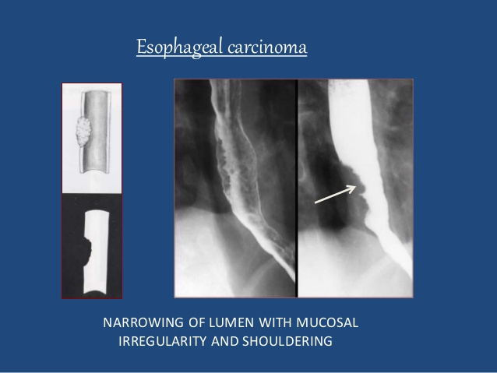
Barium swallow X rays of the Esophagus
Normal
Benign Stricture
Primary Achalasia
Hiatus Hernia
Esophageal carcinoma
DES

Slide 20
Approach to Nausea &Vomiting

Slide 21
Definitions
Vomiting (emesis): Forceful oral expulsion of gastric contents.
Nausea: Unpleasant sensation of need to vomit.
Regurgitation: passive retrograde flow of esophageal contents into the mouth without the muscular activity.
Rumination: chewing and swallowing of regurgitated food that has come back into the mouth through a voluntary increase in abdominal pressure within minutes of eating or during eating.

Slide 22
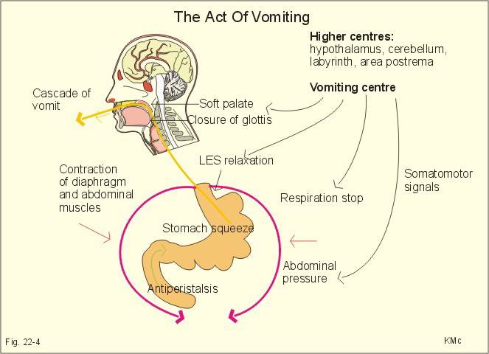
Mechanism of vomiting

Slide 23
Approach to the patient with vomiting
A comprehensive history and physical examination can often reveal the cause of nausea and vomiting, making further evaluation unnecessary especially in acute condition.

Slide 24
Approach to the patient with vomiting
Exclude pregnancy in women of childbearing age.
Acute
(<1week)
Chronic
(>1month)

Slide 25
Acute vomiting
ABC, Assess for consciousness, dehydration, bleeding, RBS → (Fluid and electrolyte replacement, hospitalisation, antiemetics, blood sampling and cross matching, blood transfusion & endoscopy in case of bleeding).
Acute sever Abdominal pain?
Yes
No
- Acute Appendicitis
- Acute Cholecystitis
- IO
- MVO
- Perforated viscus
- Renal or biliary colic
- Acute Pancreatitis
Fever?
Yes
No
Gastroenteritis
Food toxins
Viral hepatitis
Pyelonephritis
Meningitis
Myocardial infarction
DKA-ARF
Adrenal crisis
Stroke
If diagnosis isn't yet reached → go to chronic vomiting algorithm.

Slide 26
Investigations of acute vomiting
In many cases nil investigations may be required. Select as appropriate.
[A] Lab: CBC, Na, K, Creatinine, RBS, S. lipase and S. amylase, ABG, cardiac enzymes, liver functions and enzymes, Urine analysis and acetone.
[B] Imaging: Abdominal X-ray erect & supine, Abdominal U/S, CT abdomen, CT brain.
[C] ECG.

Slide 27
Suspect Cancer (Gastric - Pancreatic - Intestinal)
Chronic vomiting
Yes
Unintended Weight loss?
causing partial obstruction
Peptic disease
Crohn disease
Benign tumor
Radiation
Yes
No
Abdominal pain?
No
Medications?
Vertigo?
Headache?
Metabolic?
Others?
Digitalis
aspirin
NSAID
Anti-HTN
Antibiotics
Labyrinthine
Disorder
Ménière's disease
Sever headache
HTN
- Migraine
- Subdural Hemorrhage
- Brain tumor
- ↑ICP
- chronic renal failure
Hypo-thyroidism
Adrenal insufficiency
Seizure
Gastro-paresis
Functional vomiting
- Psychiatric illness
Eating disorder

Slide 28
Investigations of Chronic vomiting
[A] Lab: Na, K, Creatinine, BUN, TSH, stool analysis.
[B] Esophagogastroduodenoscopy.
[C] Enterography, CT abdomen - head CT or magnetic resonance imaging.
[D] GI motility studies.
[F] EEG.

Slide 29
Complication of vomiting
Aspiration of the vomitus into the air passage and lungs.
Electrolyte and water loss.
Metabolic Alkalosis.
Damage to the enamel of the teeth.
Tear of the esophageal mucosa.

Slide 30
Treatment of Nausea and Vomiting
Identify and treat the cause.
Identify and treat the complications.
Preventive measures (As in Chemotherapy).
Manage the symptoms: Antiemetics.
Metoclopramide: Extrapyramidal side effect - Diarrhea
Domperidone: Diarrhea - Hyperprolactinemia - Prolonged QR interval.
5-HT3 receptor antagonists (e.g. ondansetron): headache.

Slide 31
Approach to Dyspepsia

Slide 32
Definitions
Dyspepsia:
- Is a general term that refers to upper GI symptoms.
- Typically, patients may present with epigastric pain, heartburn, nausea, vomiting, abdominal distention, early satiety, and anorexia.
Organic dyspepsia:
- Dyspepsia associated with a specific diagnosis.
Functional dyspepsia:
- Symptom without an anatomic correlate for pain; also known as “non-ulcer” dyspepsia.

Slide 33
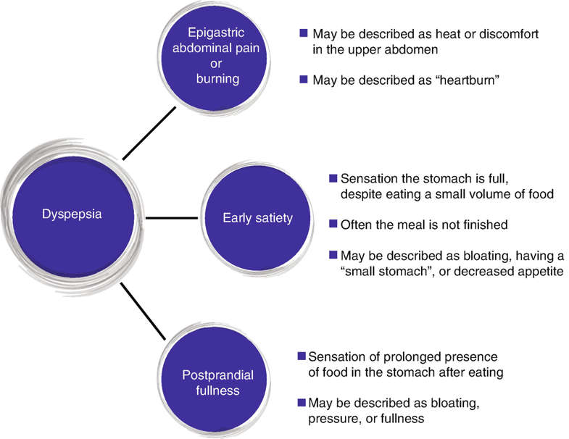
Symptoms of Dyspepsia
Epigastric Abdominal pain or burning
Early satiety
Dyspepsia
Postprandial fullness

Slide 34
Common Causes
Diagnosis | Prevalence
Functional dyspepsia | 50%
Peptic ulcer disease (gastric or duodenal ulcer) | 10%
endoscopy-negative GERD | 20%
Oesophagitis | 20%
Gastric or Oesophageal cancer | 1 %

Slide 35
Functional dyspepsia
Defined as presence of dyspeptic symptoms in the absence of an organic disease that is likely to explain these symptoms.
FD patients were divided into two groups: (Rome IV)
postprandial distress syndrome (PDS).
(2) epigastric pain syndrome (EPS).
Some patients have overlapping PDS and EPS symptoms.
The pathophysiology of FD is multifactorial and not fully understood.

Slide 36
Alarm features in patient with dyspepsia
- Dysphagia.
- Persistent vomiting.
- Unintentional weight loss.
- GI bleeding.
- Anemia.
- Palpable abdominal mass.
- Lymphadenopathy.
- Family history of upper GI carcinoma.

Slide 37
Approach to patients with Uninvestigated dyspepsia
Uninvestigated dyspepsia
Alarm feature
- Dysphagia
- Persistent vomiting
- Unintentional weight loss
GI bleeding
- Anemia
Palpable abdominal mass
- Lymphadenopathy
- Family history of upper GI
carcinoma
Age ≥60 yrs or Alarm feature or excessive worry
Yes
EGD
No
GERD Symptoms or history of NSAID use
Yes
Appropriate intervention
No
Noninvasive test for H.pylori as stool antigen or breath test
EGD = Esophago-duodenoscopy

Slide 38
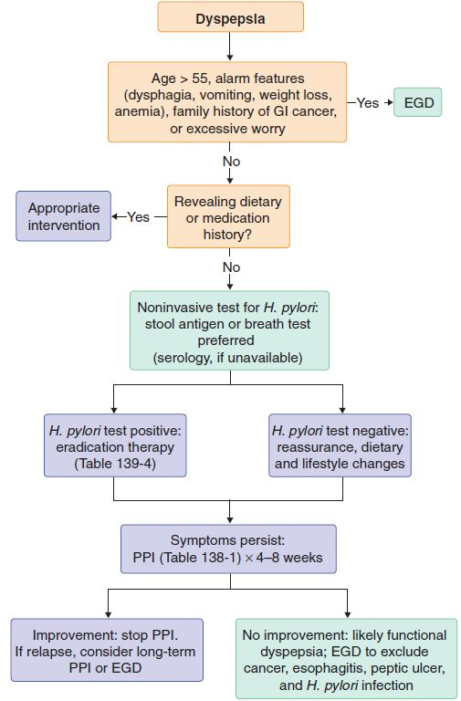
Approach to patients with Uninvestigated dyspepsia (Cont.)
Noninvasive test for H.pylori as stool antigen or breath test
H.pylori test positive
H.pylori test negative
H.pylori eradication therapy
If Fail
Empiric trial of PPIs for 4-8 weeks
If Fail
Biopsies/treatments
based on endoscopic
findings
Abnormal Endoscopic findings
EGD
Functional dyspepsia
- TCA
Prokinetic trial
Psychological therapies
If excluded
Consider other sources: hepatic, pancreas, intestine, biliary tract
Normal Endoscopic findings
Abdominal U/S - MRI or CT abdomen, enterography, colonography - colonoscopy

Slide 39
Alarm feature
- Dysphagia
- Persistent vomiting
- Unintentional weight loss
- GI bleeding - Anemia
Palpable abdominal mass
- Lymphadenopathy
- Family history of upper GI
carcinoma
Uninvestigated dyspepsia
Age ≥60 yrs or Alarm feature or excessive worry
EGD
No
GERD Symptoms or history of NSAID use
Yes
Appropriate intervention
No
Noninvasive test for H.pylori as stool antigen or breath test
H.pylori test positive
H.pylori test negative
H.pylori eradication therapy
Empiric trial of PPIs for 4-8 weeks
Fail after confirmed eradication
Failure (Treatment resistant dyspepsia)
Biopsies/treatments
based on endoscopic
findings
Abnormal Endoscopic findings
EGD
Functional dyspepsia
- TCA
Prokinetic trial
Psychological therapies
If excluded
Consider other sources: hepatic, pancreas, intestine, biliary tract
Normal Endoscopic findings
Abdominal U/S - MRI or CT abdomen, enterography, colonography - colonoscopy

Slide 40
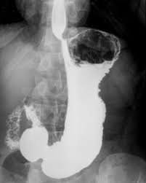
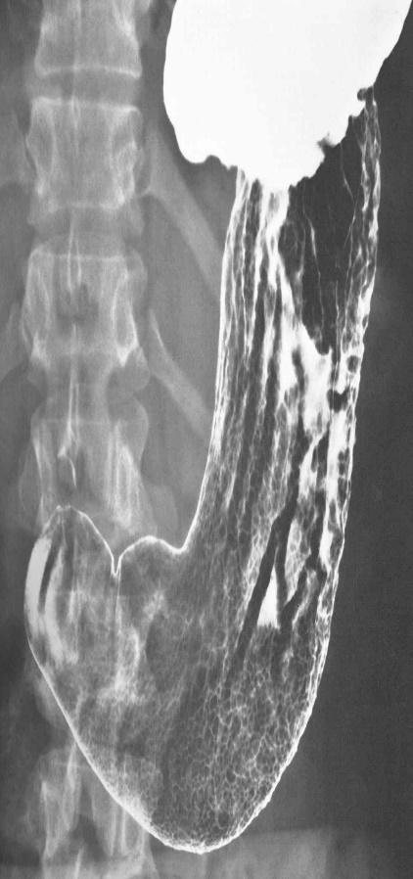
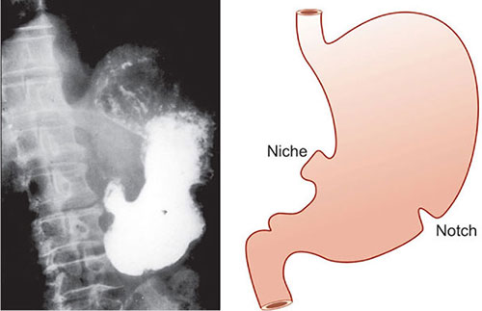
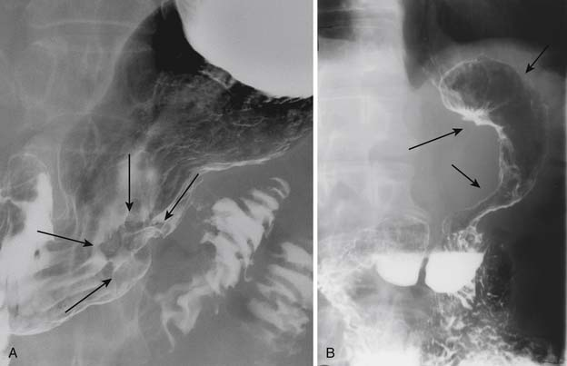
Barium meal X rays of the Stomach
Ulcer notch
Ulcer niche or crater
Normal
Gastric Ulcer
Linitis Plastica

Slide 41
Approach to abdominal pain

Slide 42
Introduction
Abdominal pain is a common symptom in patients presenting to emergency department or clinic.
Abdominal pain is a frequent manifestation of intra-abdominal disease.
It may be benign and self-limited or the presenting symptom of severe, life-threatening disease.
Abdominal pain may be classified as acute or chronic.

Slide 43
Definitions
Acute abdominal pain
- Intense pain with sudden onset reach maximum over minutes, hours or days.
- It is often suggests serious physiologic alterations which need urgent intervention.
Chronic abdominal pain:
- Pain has period of remission and exacerbation with interval of relief in between. It may be present for several months.
Not mandate immediate attention, & may need prolonged evaluation.
Don’t forget: Acute on top of chronic abdominal pain.

Slide 44
How to Approach??
HISTORY:
It is the most important part in diagnostic process
(1) Analysis of abdominal pain
Onset: Sudden or gradual Course: progressive or remission & exacerbation. Duration Duration of single episode Frequency | Site (indicates the affected organ). Radiation (referred)
 | Character (type) Intensity
- What increase - What decrease | - Relation to meal time & type - Occur during sleep
- Associated symptoms e.g. nausea, vomiting, constipation, diarrhea, dysuria, jaundice, GIT bleeding, fever

Slide 45
Types (Character) Of Abdominal Pain
[A] Visceral (poorly localized)
- Burning pain: GERD. - Colic crampy pain: Hollow viscus. Heaviness: Organomegally. Dull aching: originates in abdominal organs covered by peritoneum or stretch of capsule or chemical inflammation as in PUD.
[B] Somatic | [C] Referred
From abdominal wall or due to irritation of parietal peritoneum. Sharp, well localized. | Pain arising from lesions outside abdomen & referred to abdomen. Some abdominal lesions referred to another location.

Slide 46
How to Approach??
HISTORY: (Cont.)
(2) Other medical illness e.g. DM, IHD.
(3) Drug history.
(4) History of drug abuse, alcohol drinking, travelling abroad.
(5) Menstrual history & pregnancy.
(6)Previous surgery.
(7) Family history: IBD - Cancer.

Slide 47
How to Approach??
PHYSICAL EXAMINATION:
General Appearance & decubitus:
- Leaning forward: pancreatitis.
- Flat, flexed L.L. & avoid any movement: peritonitis.
Hand on abdomen, change position as unable to find a comfortable position: Intestinal colic (obstruction).
Body built: Loss of weight in malnutrition or cancer.
Complexion: Jaundice - pallor.

Slide 48
How to Approach??
Vitals:
Fever: gastroenteritis, IBD, appendicitis, cholecystitis, diverticulitis. High grade in cholangitis, pyelonephritis PID.
Hypotension or tachycardia: intravascular depletion due to poor oral intake, acute GI or intra-abdominal bleeding, severe diarrhea, or peritonitis.
Skin lesions:
- Liver disease (jaundice, spider telangiectasias, palmar erythema).
- IBD (erythema nodosum, pyoderma gangrenosum).

Slide 49
How to Approach??
Local Abdominal examination:
Inspection: scars, masses, ecchymosis, distention.
Palpation: (starting in an area away from the pain)
- Generalized Peritonitis in perforated viscus: tenderness, rebound tenderness, guarding, rigidity.
- Localized tenderness - rebound: appendicitis, cholecystitis.
- Masses and enlarged/tender organs.

Slide 50
How to Approach??
Local Abdominal examination: (cont.)
Percussion: ascites - organomegally.
Auscultation: bowel sounds, bruits.
PR and Pelvic examination: Performed in perianal or rectal symptoms, incontinence, difficult defecation, suspected IBD.

Slide 51
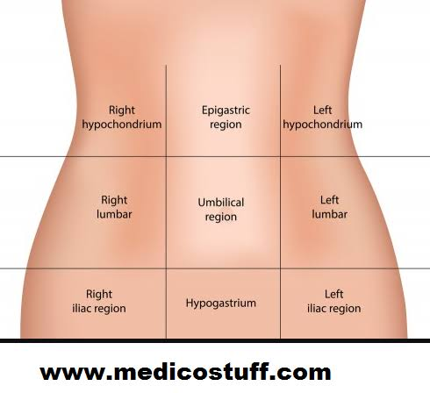
- Inferior MI, Pericarditis
- GERD, Esophagitis
- PUD, Gastritis, Perforated ulcer
- Pancreatitis
- Ruptured aortic aneurysm
- Cholecystitis, Cholangitis
- Hepatitis, congested liver, liver abscess
- Budd-Chiari syndrome
- Pneumonia/empyema/
Pleurisy/pleurodynia
- Subdiaphragmatic abscess
- Splenic infarct, rupture, abscess
- Gastritis, Gastric ulcer
- Pancreatitis
- Pneumonia/empyema/ Pleurisy/pleurodynia
- Subdiaphragmatic abscess
- Early appendicitis
- Gastroenteritis
- Bowel obstruction
- Colitis, IBS
- Ruptured aortic aneurysm
- Pyelonephritis,
- Hydro/Pyonephrosis
- Renal infarct, abscess
- Renal/Ureteric stones, colic
- Splenic affection (as above)
- Pyelonephritis,
- Hydro/Pyonephrosis
- Renal infarct, abscess
- Renal/Ureteric stones, colic
- Diverticulitis
- Salpingitis
- Inguinal hernia
- Ectopic pregnancy
- Ureteric stones, colic
- IBD
- IBS
- Mesenteric lymphadenitis
- Typhlitis
- Diverticulitis
- Salpingitis
- Inguinal hernia
- Ectopic pregnancy
- Ureteric stones, colic
- IBS
- IBD
- Sigmoid volvulous
- Cystitis, Urine retention
- Menstrual pain (cramps)
- Pregnancy
- Uterine fibroid
- Endometriosis, PID
Abdominal pain according to site

Slide 52
Diffuse non-localized pain
Nonsurgical causes | Surgical causes
- Gastroenteritis - Familial Mediterranean fever - Metabolic disturbances (DKA, Renal failure , porphyria) - Sickle Cell Crisis Psychogenic illness Acute Adrenal insufficiency | - Intestinal Obstruction - Generalized peritonitis - Acute Pancreatitis - Mesenteric Thrombosis Dissecting or Rupturing Aneurysm

Slide 53
N.B.
The location of the pain can assist in narrowing the differential diagnosis; however, the chronological sequence of events in the patient’s history is often more important than the pain’s location.

Slide 54
Alarm features (Red flags)
Acute abdomen per se is alarming symptoms.
Rapid onset Abdominal distension: intra-abdominal hemorrhage, intestinal obstruction, ileus.
Unexplained hypotension: Due to hemorrhage or sepsis.
Generalized peritonitis: perforated viscus.
Weight loss.
GIT bleeding.
Anemia.
Fever.
Frequent nocturnal symptoms.
Vomiting.

Slide 55
Investigations
Laboratory tests:
CBC: Leukocytosis - Anemia.
Liver enzymes & function tests: ALT, AST, Alk.P., GGT, T.Bil, Direct Bil.
RBS - Acetone in urine.
Creatinine, BUN, NA, K, ABG.
Serum amylase & lipase.
Cardiac enzymes.
Complete urine analysis.
Pregnancy test: female in childbearing period.

Slide 56
Investigations (cont.)
Imaging :
Plain X-rays: Erect & left lateral decubitus for suspected perforated viscus.
Ultrasound: cholecystitis or appendicitis, extrahepatic biliary obstruction, obstructive uropathy & nephrolithiasis.
CT scanning: confirm diagnosis - pancreatitis - allow prompt diagnosis of unsuspected abdominal diseases
Contrast studies - barium (upper and lower GI series).
Endoscopy: UGI endoscopy - Sigmoidoscopy – colonoscopy.

Slide 57
N.B.
In case of acute abdomen, early surgical consultation should be obtained, even in doubtful cases, rather than awaiting confirmation of the diagnosis via laboratory or radiologic studies.

Slide 58
Organic Versus Functional Pain
FUNCTIONAL | ORGANIC | HISTORY
Less likely to change | Acute, persistent pain increasing in intensity | Pain course
Various locations | Sharply localized | Pain localization
No affect | Awakens at night | Pain in relation to sleep
Headache, dizziness, multiple system complaints | Fever, anorexia, vomiting, weight loss, anemia, elevated ESR | Associated symptoms
Present | None reported | Psychological stress

Slide 59
Non-surgical cause of acute abdomen
Extra abdominal causes | Metabolic - Endocrinal
- Acute myocardial infarction Pneumonia with pleuritis | - DKA - Uremia - Acute adrenal insufficiency - Porphyria
Neurological | Others
- Herpes zoster neuralgia - Tabes dorsalis - Causalgia - Radiculitis from infection or arthritis - Spinal cord or nerve root compression | - Familial Mediterranean fever - Psychiatric disorders

Slide 60
Common surgical causes of acute abdominal Pain
Appendicitis.
Intestinal obstruction.
Cholecystitis.
Pancreatitis.
Perforation of an ulcer.
Acute diverticulitis.
Pelvic disorders.
Ruptured Abdominal aortic aneurysm [AAA].

Slide 61
Common causes of chronic abdominal pain
Irritable bowel syndrome (IBS).
Gastroesophageal reflux disease (GERD).
Duodenal ulcer.
Gastric ulcer.
Chronic pancreatitis.
Diverticulosis.
Inflammatory bowel disease.

Slide 62
Abdominal distention

Slide 63
Etiologies of abdominal distention
Sixth Fs | Etiology
Flatus (gaseous distension) | Bowel obstruction - paralytic ileus - IBS - Gas bloat (parasites - lactase deficiency).
Fluid (Ascites) | Liver cirrhosis, Budd-chiari $, Heart failure, Nephrotic $, rupture aortic aneurysm.
Feces | Stool can accumulate in the colon → colon distended + gaseous distension of proximal bowel
Fetus | Pregnancy.
Fat | Obesity.
Filthy big tumors | Hepatomegaly - Splenomegaly - Polycystic kidney - Ovarian cyst - Fibroid - Obstructed urinary bladder - Intra-abdominal tumor.

Slide 64
History
History:
- Abdominal pain: may rise suspicious of surgical cause especially if sever.
- Bowel habit: constipation.
- History of chronic illness: Liver, Heart, Kidney for ascites.
- Menstrual history.

Slide 65
Clinical Examination
General examination:
- Decubitus: Orthopnea: massive ascites.
- BMI: overweight & obesity.
- Vital data.
- Congested neck vein in heart failure.
- Finding of liver cell failure: jaundice, silky hair, foeter hepaticus, enlarged parotid, palmer erythema, flapping tremors, spider nevi, gynecomastia, LL edema.

Slide 66
Clinical Examination
Local abdominal examination:
- Inspection: Generalized or localized distention.
- Palpation:
Superficial palpation for peritoneal irritation.
Organomegally, Pelvic mass: arises out of the pelvis so that the examining hand cannot palpate an inferior border.
Faeces is felt as firm to hard lumps that are indentable when prodded with the tip of the examining finger.

Slide 67
Clinical Examination
Local abdominal examination: (Cont.)
- Percussion:
Shifting dullness → moderate ascites , Fluid thrill → tense ascites
Generalised hyper-resonance→ gaseous distention
- Auscultation:
Hyperactive bowel sounds → mechanical obstruction
Absent or just a few ‘tinkly’ bowel sounds → paralytic ileus.

Slide 68
Investigations
Lab.:
- Liver enzymes & function
- Kidney function test and electrolytes
- Stool analysis for parasites & ova
- Pregnancy test
Imaging
- Abdominal x-ray erect & supine
- Pelvi-abdominal U/S
- CT pelvi-abdomen
- Echocardiography
Ascitic sample: SAAG

Slide 69
Quizzes

Slide 70
Quiz (1)
A 35-year-old lady presents with intermittent difficulty swallowing which has been present for 3 months. The dysphagia occurs to both solids and fluids equally. Otherwise she is perfectly well & denies any previous history of prolonged heartburn.
What is the likely diagnosis?
Oesophageal spasm
oesophageal ring
Oesophageal cancer
Peptic stricture
Notes:
A

Slide 71
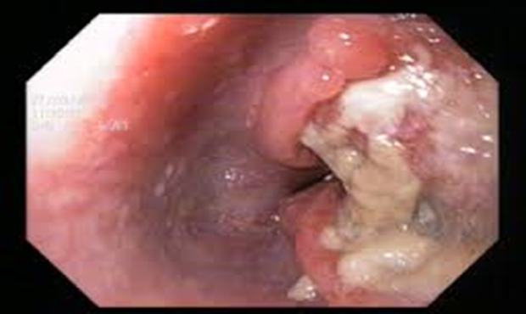
Quiz (2)
A 60 year-old retired army officer presents with dysphagia. He says it came on gradually and initially only noticed it with solid food but more recently has been having symptoms with soft foods also. He has vomited after eating on a few occasions recently but denies nausea or change in appetite. He is previously fit and well, he does not smoke.
What is the most likely cause for
his symptoms?
Oesophageal cancer
Achalasia
Pharyngeal pouch
Gastro-oesophageal reflux disease (GORD)
Pharyngitis

Slide 72
Quiz (3)
A 51 year old man presents with intermittent dyspepsia, relief with antacids, he is smoker with family history of PUD. He denies any symptoms of bleeding, dysphagia or weight loss. He is not on any current repeat medication. Examination is normal.
What ongoing management should you recommend?
Upper GI endoscopy
PPI for 1 month
full dose PPI for 1 week
Notes:
C

Slide 73
Quiz (4)
A 61 year old man presents with epigastric pain of three months duration. He also noticed loss of 3 Kg of weight over the last month. He is smoker with family history of PUD. He denies any symptoms of bleeding or dysphagia. He is not on any current repeat medication. Examination is normal.
What ongoing management should you recommend?
Upper GI endoscopy
PPI for 1 month
full dose PPI for 1 week
Notes:
A

Slide 74
Home message
Good history taking and physical examinations are important for proper use of investigations and to reach proper diagnosis.
Neuromuscular causes are more common in oropharyngeal dysphagia while structural causes are more with esophageal dysphagia.
Acute vomiting mayn’t need investigations
Exclude organic causes before diagnosis of any functional GIT disorders.
Don’t miss non-surgical causes of acute abdomen.

Slide 75
References
Fauci, AS, Kasper DL, Hauser SL, Longo DL, Loscalzo J (Eds.) (2018). Harrison's Principles of Internal Medicine (20th ed.). New York: McGraw-Hill Education.
Goldman L, Schafer Al (Eds) (2020). Goldman-Cecil Medicine (26th ed.). Philadelphia, PA: Elsevier.
Benjamin IJ, Griggs RC, Wing EJ, Fitz JG (Eds.) (2016). Andreoli and Carpenter’s Cecil Essentials of Medicine (9th ed.). Philadelphia, PA: Elsevier Saunders.

Slide 76
References
Moayyedi P, Lacy BE, Andrews CN, Enns RA, Howden CW, Vakil N. ACG and CAG Clinical Guideline: Management of Dyspepsia. Am J Gastroenterol. 2017 Jul;112(7):988-1013. doi: 10.1038/ajg.2017.154.
Malagelada JR, Bazzoli F, Boeckxstaens G, et al. World gastroenterology organisation global guidelines: dysphagia--global guidelines and cascades update September 2014. J Clin Gastroenterol. 2015;49(5):370‐378. doi:10.1097/MCG.0000000000000307.

Slide 77
Thank You

